Slide 1


The Assessment Data Journey: Are We There Yet?
Date

Slide 2
What Is the Assessment Data Journey: Are We There Yet?
The Assessment Data Journey: Are We There Yet? is a suite of three tools that provide information about the process by which states collect, validate, submit, and report data for Part B Indicator 3.
an online interactive infographic with critical junctures during which the viewer can access critical information about the process
this PowerPoint display of the information in the infographic is intended for users who cannot access the online version
a Dialogue Guide to accompany the online interactive infographic and the PowerPoint display

Slide 3
What Is the Assessment Data Journey: Are We There Yet? (cont.)
This resource gives an overview of the typical process for collection, validation, submission, and reporting of assessment data and provides insights about
crucial points where the special education process differs from that of general education
instances when clarifying key terms, expectations, and processes among staff may be helpful
occasions where challenges or miscommunications may arise
opportunities for staff across divisions to collaborate to support timely, accurate, and complete submission of data

Slide 4
Purpose and Context
States need to submit timely, accurate, and complete assessment data about their students with disabilities to the U.S. Department of Education (ED)
Ensuring that the assessment data they submit is of high-quality can be challenging because other program areas outside of special education, with different priorities and timelines, most often manage and control the data sources
Collaboration and coordination across divisions or offices within state education agencies (SEAs) that support assessment data collection, validation, submission, and reporting is critical to the process

Slide 5
It’s Time to Take the Assessment Data Journey!

Slide 6
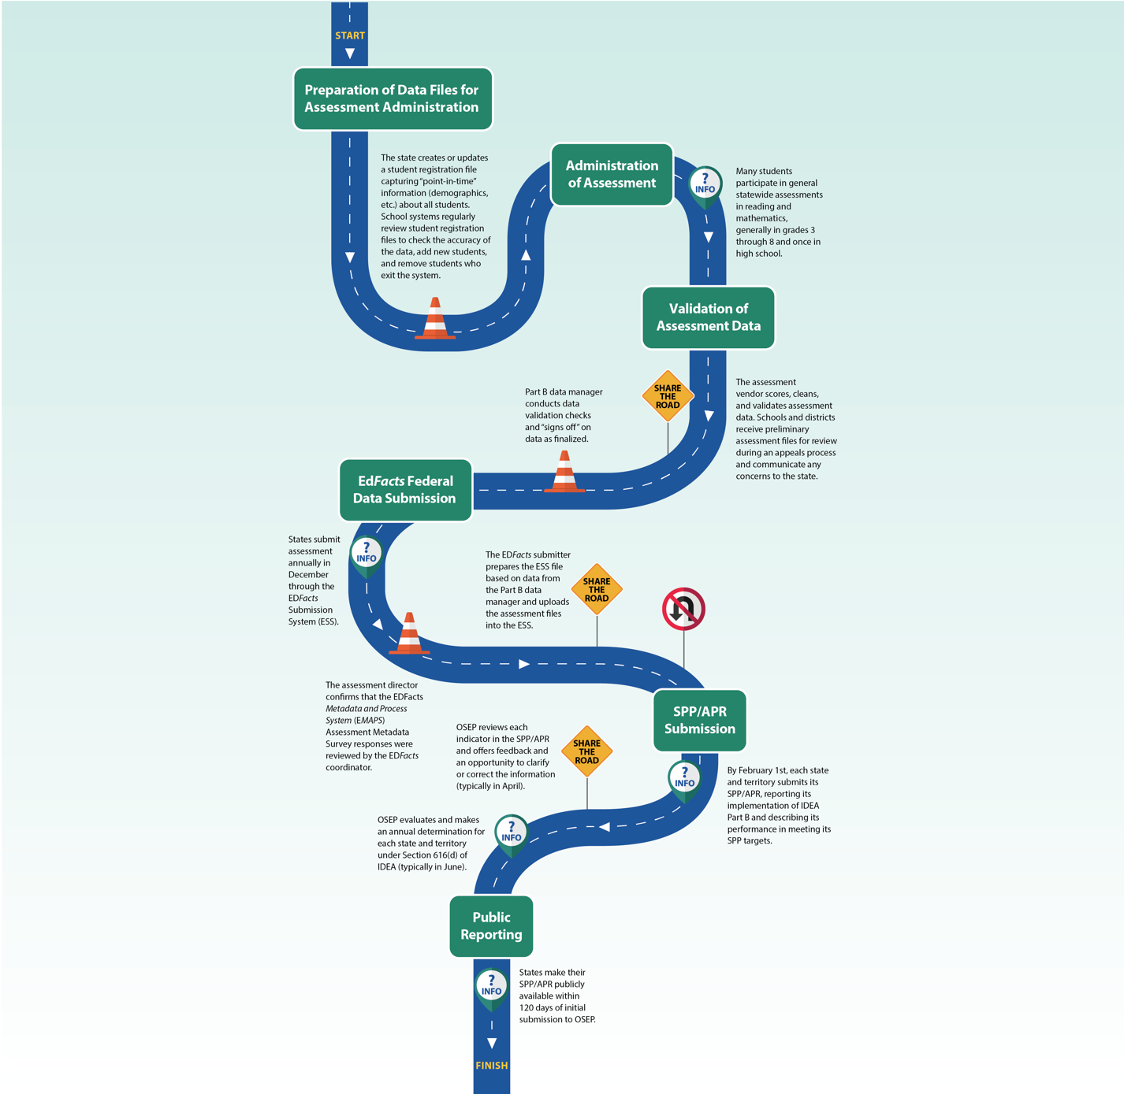
The Assessment Data Journey
Data for Part B Indicator 3 follow a long and complicated road that begins when a student is registered as a test taker in a state assessment system and ends with public reporting of the data via the State Performance Plan/Annual Performance Report (SPP/APR).

Slide 7
The Assessment Data Journey (cont.)
Part B Indicator 3 data collection requires involvement from multiple state agency staff and others
Special education staff
Assessment staff
EDFacts coordinator and submitter
Assessment vendors
Others

Slide 8
The Assessment Data Journey (cont.)
It is critical that everyone on the assessment data journey has a clear understanding of the process by which the state collects, validates, submits, and reports data for Part B Indicator 3.

Slide 9

Follow along the Part B Indicator 3 roadway for general information about the process and note a variety of road signs that provide valuable insights about the road to high-quality assessment data.
9

Slide 10




Part B Indicator 3 Roadway Signs
junctures where building additional understanding of key terms, expectations, and processes may be helpful for all relevant parties;
crucial points where the special education process differs from that of general education;
instances where possible challenges or miscommunications may arise; and
opportunities for staff across divisions to collaborate to ensure timely, accurate, and complete submission of data.

Slide 11
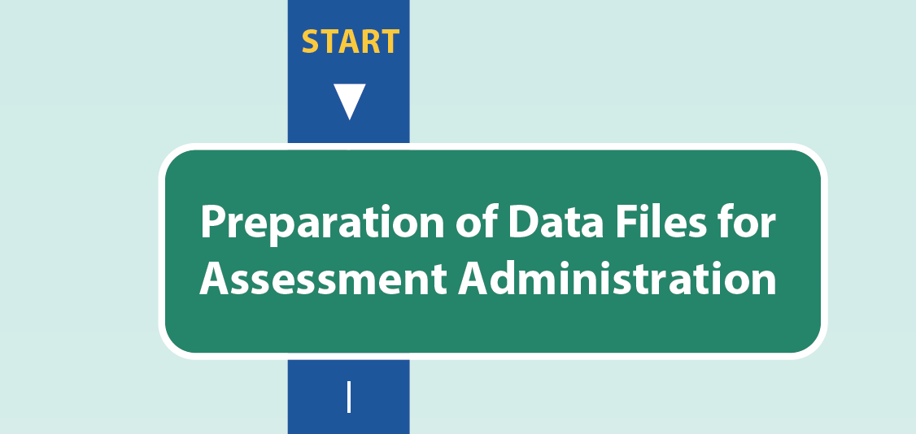
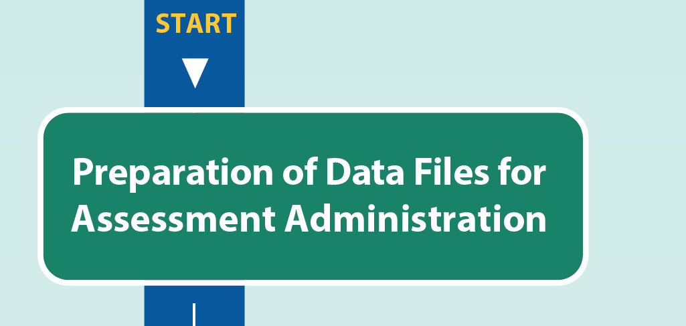

Slide 12
Preparation of Data Files for Assessment Administration
The state creates or updates a student registration file capturing “point-in-time” information (demographics, etc.) about all students. School systems regularly review student registration files to check the accuracy of the data, add new students, and remove students who exit the system.

Slide 13



Slide 14
Preparation of Data Files for Assessment Administration (cont.)
Accuracy of student data is paramount, as states use the information in the registration file to identify students to be included in specific reporting categories for federal programs.

Slide 15
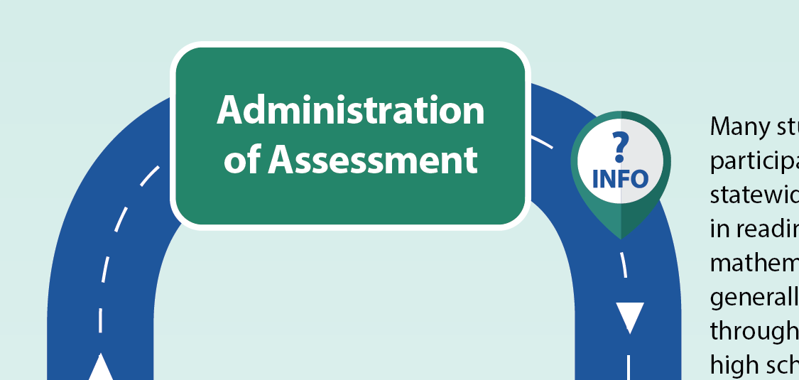


Slide 16
Administration of Assessment
Many students participate in general statewide assessments in reading and mathematics, generally in grades 3 through 8 and once in high school.

Slide 17
Administration of Assessment (cont.)
Eligible students with significant cognitive disabilities participate in the statewide alternate assessment in reading and mathematics, generally in grades 3 through 8 and once in high school.

Slide 18
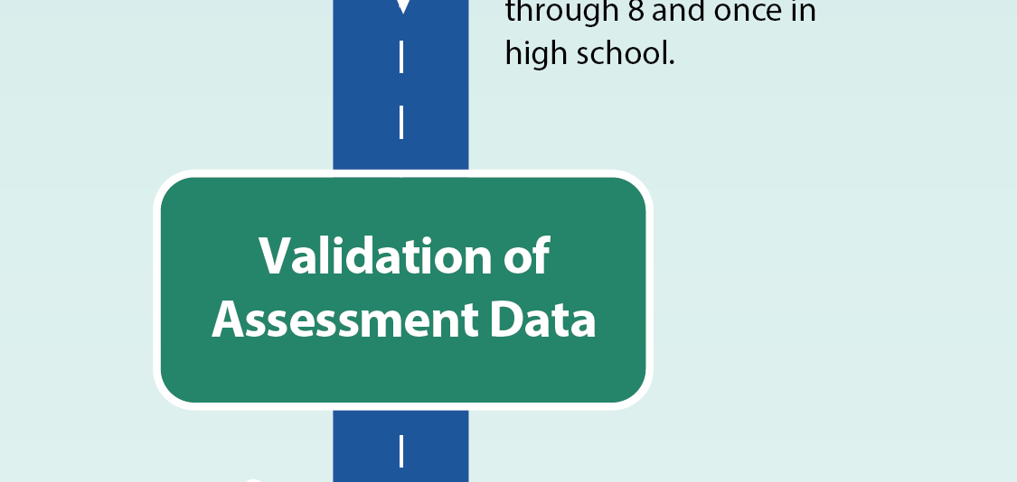


Slide 19
Validation of Assessment Data
The assessment vendor scores, cleans, and validates assessment data. Schools and districts receive preliminary assessment files for review during an appeals process and communicate any concerns to the state.

Slide 20
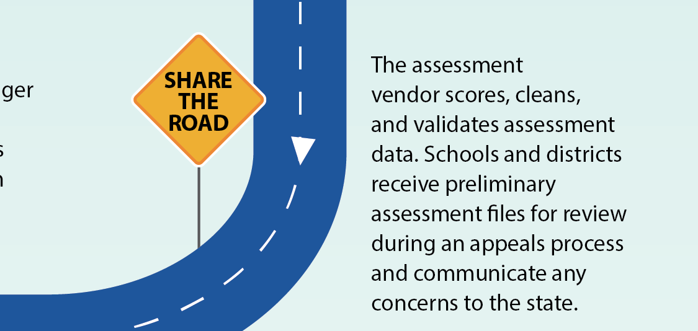

Slide 21
Validation of Assessment Data (cont.)
It is important that everyone at the state education agency, including the Part B data manager, EDFacts coordinator, and assessment staff, is aware of any data quality concerns raised by school systems.

Slide 22
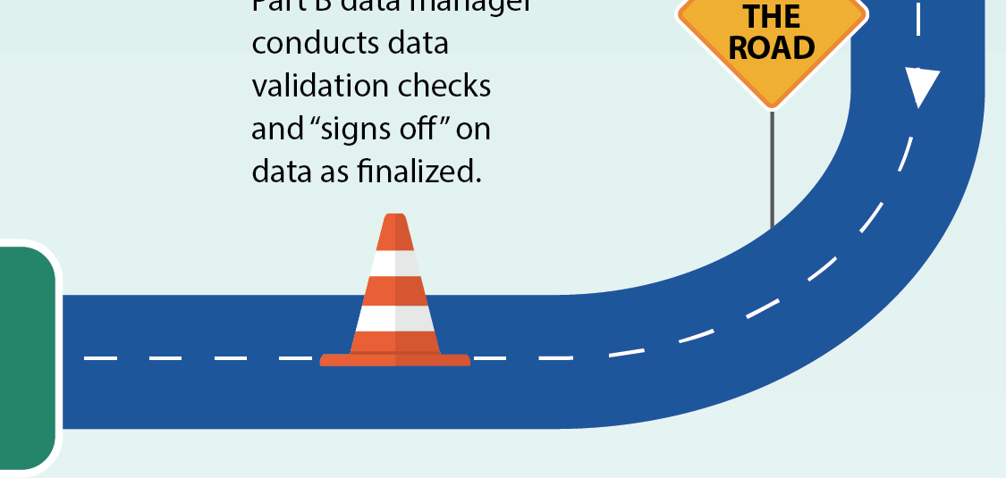


Slide 23
Validation of Assessment Data (cont.)
Part B data manager conducts data validation checks and “signs off” on data as finalized.

Slide 24
Validation of Assessment Data (cont.)
Accuracy of these data is critical because the U.S. Department of Education uses them to pre-populate Indicator 3 in the SPP/APR.

Slide 25
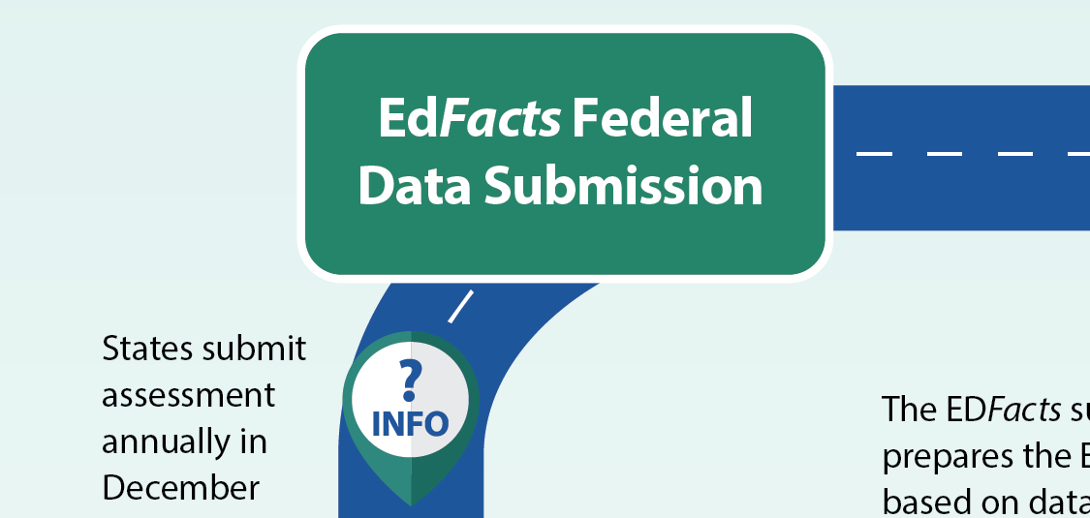


Slide 26
EDFacts Federal Data Submission
States submit assessment annually in December through the EDFacts Submission System (ESS).

Slide 27
EDFacts Federal Data Submission (cont.)
ESS is an electronic system states use to submit a core set of key PreK-12 performance data.

Slide 28
EDFacts Federal Data Submission (cont.)
The assessment director confirms that the EDFacts Metadata and Process System (EMAPS) Assessment Metadata Survey responses were reviewed by the EDFacts coordinator

Slide 29
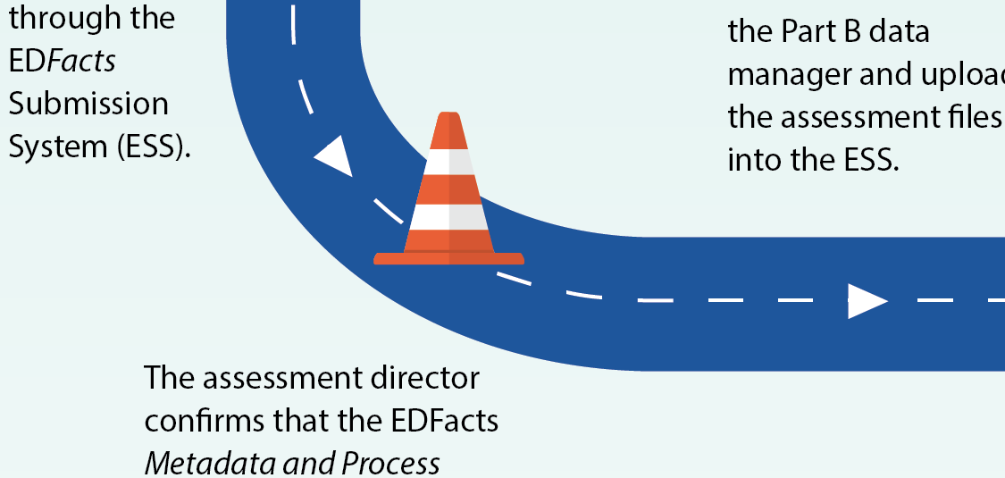


Slide 30
EDFacts Federal Data Submission (cont.)
If metadata responses do not align with reported EDFacts data, Office of Special Education Programs (OSEP) considers the data submission as incomplete in their evaluation of the data quality for IDEA accountability.

Slide 31
EDFacts Federal Data Submission (cont.)
The EDFacts submitter prepares the ESS file based on data from the Part B data manager and uploads the assessment files into the ESS.

Slide 32
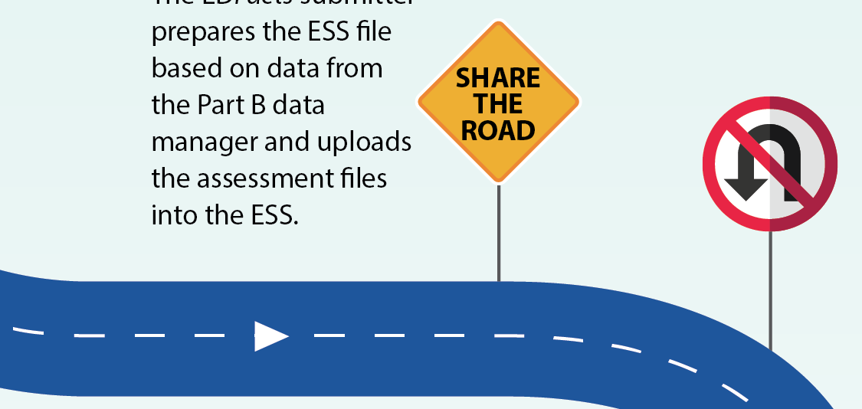

Slide 33
EDFacts Federal Data Submission (cont.)
Relevant staff (e.g., the Office of Assessment, EDFacts coordinator, Part B data manager) should work together to address any inconsistencies. All emails related to the EDFacts submission should copy relevant staff.

Slide 34
EDFacts Federal Data Submission (cont.)
States can resubmit data after the December deadline, but OSEP considers this deadline to be firm for the purposes of timeliness, accuracy, and completeness. These are elements of a state’s compliance matrix and may impact a state’s annual OSEP Determination under Section 616(d) of IDEA.
States can resubmit data after the December deadline, but OSEP considers this deadline to be firm for the purposes of timeliness, accuracy, and completeness
These are elements of a state’s compliance matrix and may impact a state’s annual OSEP Determination under Section 616(d) of IDEA

Slide 35
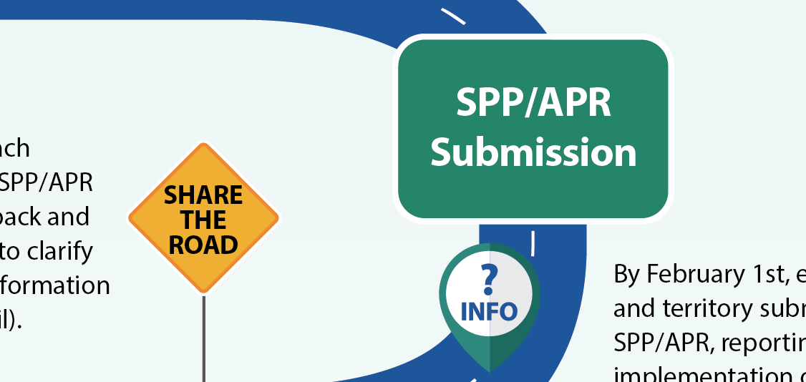



Slide 36
SPP/APR Submission
By February 1st of each year, states and territories submit their SPP/APR, reporting on implementation of IDEA Part B and describing performance in meeting SPP targets

Slide 37
SPP/APR Submission (cont.)
Many of the EDFacts data files pre-populate the IDEA Part B SPP/APR. States submit their SPP/APR electronically through the APR Tool built on the EDFacts EMAPS platform.

Slide 38
SPP/APR Submission (cont.)
OSEP reviews each indicator in the SPP/APR and offers feedback and an opportunity to clarify or correct the information (typically in April).

Slide 39
SPP/APR Submission (cont.)
State special education staff may need to collaborate with staff from other divisions (e.g., assessment, EDFacts coordinator) to address issues noted during clarification period.

Slide 40

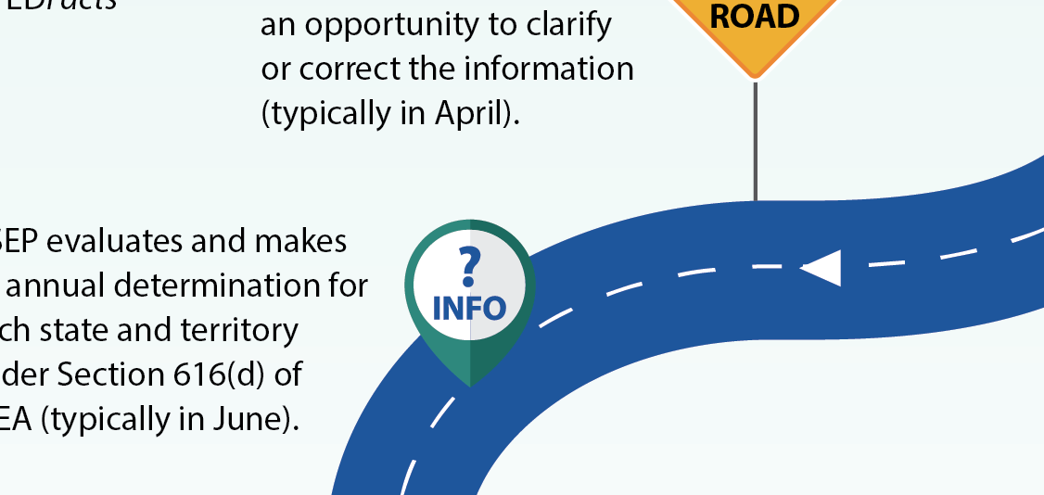

Slide 41
SPP/APR Submission (cont.)
OSEP evaluates and makes an annual determination for each state and territory under Section 616(d) of IDEA (typically in June).

Slide 42
SPP/APR Submission (cont.)
OSEP uses the Results Driven Accountability (RDA) Matrix to make annual determinations. The RDA Matrix consists of a Compliance Matrix and a Results Matrix.

Slide 43
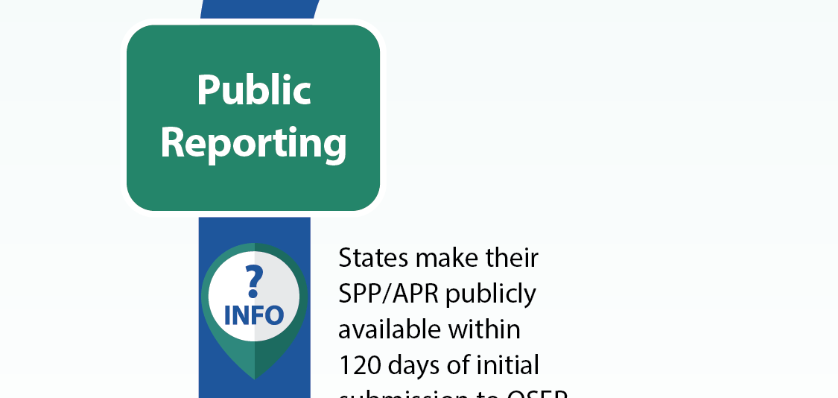

Slide 44
Public Reporting
States make their SPP/ APR publicly available within 120 days of initial submission to OSEP.

Slide 45
Public Reporting (cont.)
See IDEA Data Center website resources for more information on IDEA Section 618 assessment public reporting requirements.

Slide 46
IDC Assessment Resources
Assessment Data Journey: Are We There Yet? (online infographic)
SEA Data Processes Toolkit
618 Data Collection Protocols: Assessment
616 SPP/APR Indicator Protocols: Indicator 3. Assessment
Your IDC State Liaison is your central point of contact for IDC technical assistance. Find your State Liaison through the IDC website.

Slide 47


For More Information
Visit the IDC website http://ideadata.org/
Follow us on Twitter https://twitter.com/ideadatacenter
Follow us on LinkedIn
http://www.linkedin.com/company/idea-data-center

Slide 48
48

